Slide 1
Visualizing Neural Nets
By Daniel Fishbein and Jivitesh Debata
Notes:
Final Q/A-
JIV- DONE
DAN-PENDING

Slide 2
ARITHMOPHOBIA WARNING
The rest of this presentation may not be appropriate for some audiences.
Viewer discretion is advised.
Notes:
Notes
Final Q/A- JIV DONE

Slide 3
Summary:
Our story starts with Caution
Can we predict when Neural networks will fail
Brute Force Approach
Viewing the minima
Project Goal
Previous Work
First task
Our Second task
Our Experiment
Our Third Task
This is where we are now
Future work
Current Related Work
What we learned through this process?
Sources
QA
Notes:
Summary Slide We layout the presentation plan
(note to self first three slides are skimmed very fast)

Slide 4

Our story starts with “Caution”.
Notes:
Add pick of Title slide from this presentation Yes?as in what would you want the notes to be?
Our story starts with caution
We want to explain
PERFECT
Story style format
We walk them through each “Milestone? “
Where we really picked it up ? OpenSet/ Closed Set / A drone following a human
Quotes- “ Our story starts with the presentation caution .Doe anybody remember this? “ pause
Take questions. Answer

Slide 5
Criticisms of “Caution”.
“Cool idea but ‘Caution’ is not clearly defined.”
“What are you guys trying to do?”
Could you be less vague on what you want to do??
Notes:
Largest criticism of this presentation was: it was unfocused. “Caution” wasn’t clearly defined
What on earth is caution. FRom the feedback we basically got
Wtf
This has been done
This is cool Can you make it less vague
It sounds cool
Can you define what you want to show
Note - Joke slide(Semi serious slide. Because criticism is actually valid”

Slide 6
What we decided to do:
Focused on when AI messes up.
Can we predict when NN’s will fail?
Notes:
We really focused in on the idea of when AI messes up.
Taking that criticism we decided to focus on
When does this thing fail ?
Specifically not succeed but fail .

Slide 7
Can we predict when NN’s will fail?
Explainable AI - “Explainable AI (XAI), also known as Interpretable AI, or Explainable Machine Learning (XML),^{[1]} is artificial intelligence (AI) in which humans can understand the reasoning behind decisions or predictions made by the AI.” - Wikipedia
Prediction accuracy
Traceability
Decision understanding
-IBM
Notes:
Pulled directly from https://www.ibm.com/watson/explainable-ai
What on earth is XAI
2mins DAN in terms of math
2mins of JIV which is how math lies?
Accuracy is a key component of how successful the use of AI is in everyday operation. By running simulations and comparing XAI output to the results in the training data set, the prediction accuracy can be determined. The most popular technique used for this is Local Interpretable Model-Agnostic Explanations (LIME), which explains the prediction of classifiers by the ML algorithm.
Traceability
Traceability is another key technique for accomplishing XAI. This is achieved, for example, by limiting the way decisions can be made and setting up a narrower scope for ML rules and features. An example of a traceability XAI technique is DeepLIFT (Deep Learning Important FeaTures), which compares the activation of each neuron to its reference neuron and shows a traceable link between each activated neuron and even shows dependencies between them.
This is the human factor. Many people have a distrust in AI, yet to work with it efficiently, they need to learn to trust it. This is accomplished by educating the team working with the AI so they can understand how and why the AI makes decisions.
While these are great noble ideas. They are not actually helping us in what we are trying to do. For example
One of the most common practises for explainable AI is to have one neural net make a decision and have another AI explain that to another user
DIRECT QUOTE FROM JIV AND DAN- “ XAI according to our humble opinion is trying to explain a blackbox with another black box”
There are other approaches but they are not useful for us. They have fundamental basic principle problems that make it not really useful for us
Questions will arise. Simple answer. WE DONT CARE. What are its limits - note to jivi .(before running it .remember DAN) Next

Slide 8
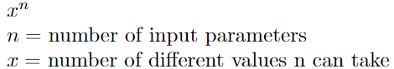
The Brute-Force Approach
The input space of a Neural Net is :
Notes:
The simplest of simplest of logic.
Dimensionality
What is dimensionality
Features? - > Engineers
Dimensions>?-> Maths
AI engineers and Machine Learners have lost the forest focussing in on the trees - DAN & JIV
A specific example of this is this brute force approach
Story telling time
Dan- Let search all of it
Natural question- Well what is all of it
Dan - Well next slide

Slide 9
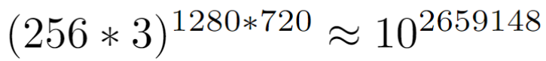
The Brute-Force Approach
A Neural Net image classifier that takes 1280 X 720 colored images has an input space of:
Notes:
Well this is HOW BIG
If we take a normal HD 720p image of RGB
What are the dimensions
If each and every pixel is dimension “Technically”
Then the answer to the previous slide is a number that is hilariously larger than the atoms in the observable universe
And this is logically natural
Things get lost
Idea of getting lost by being in a environment that is already too big to observe or actually keep track of
Simple idea
Find a marble in a circle
Find a marble in a bucket of water.
(pause)
Now take that bucket and imagine it in 2d. Will it be easier or harder to find the marble in the 2d bucket.?i.e circle
(pause)
Now take that 2d bucket and imagine it in 1d. Will it be easier or harder to find the marble in the 1d bucket.?i.e a line
(pause)
Well naturally going down in dimensions is easier to find a marble in a bucket.
What if we make our 3d bucket, 4d? Will it be easier to harder to find our marble?
<Pause>
Audience has to answer this
Now imagine a bucket in 10,000 dimensions. How about 921600dimensions. (the exponent)
Now replace that marble or point with an input you care about
This should feel intuitive . (Expect questions here. BE PATIENT TO BREAK IT DOWN - Note to JIV)
Is it easier or harder to find the marble in higher dimensions?
Thanks

Slide 10
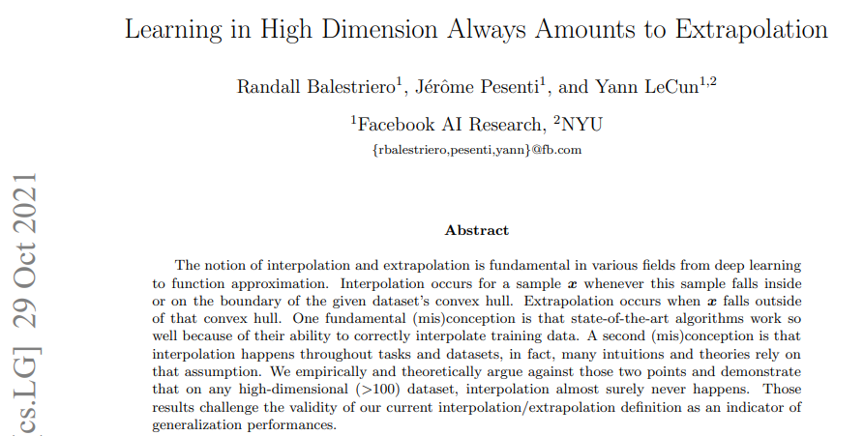
Paper published in 2021
Notes:
This is not producing anything new
This By META .Actual META
They have genuinely lost sight of whats going on - in our humble opinion
They have and we repeat “AI engineers and Machine Learners have lost the forest focussing in on the trees - DAN & JIV “
Expect questions
What does this paper say in short ELI5:
This paper points out that as dimensions increase the volume of a shape increases exponentially. This means that if you will be pulling a smaller and smaller portino of the sample space for training asdimentionas rise. After 100 dimentions (100 pixel image - 10pX10p) you are hoplessly lost and will never get a sample on a boundery condition. This leads to the conclusion that NN will always be extrapolating (trying new data) rather than inerpolaing (sampling old data). They also warn agains using dimentionalaity reduction techniques to analyse the data (the grouping). these techniques will give a miss representation of the actual shape of hte oject and atificially put htings together that are not supposed to be.
First part about growing spaces makes sense and seams obvious to most math people. I am not sure why this needed to be said in a 2021 paper. feels like old news.
the second part about viewing data in high dimentions using dimentionality reduction, while I understand that it allwos for charry picking (see figure 5) i wouldnt say its useless. Rather, there is more there than just what is shown. there is a way to do dimentionality reduction correctly but you probably need to do more to find hte shape of the data and thus the corisponding technique that is the least cherry picked. IDK what those techniques are though.
Obviously the paper is nuanced and complex . THIS NOT GROUND BREAKING.

Slide 11
The moment of clarity
Machine learning, specifically Neural Nets, is taught as: “The weights are randomly initialized and optimized during the training to minimize a loss function.” - [1]. “The Network is trying to find the ‘local minima’ where it gets the best results” - Every Introduction to AI ever. ~CSCI 635
What if we didn’t care about finding a better minima and wanted to view the minima we are at?
Notes:
Introduce the idea of NN finding a local minima and viewing that minima as an uneven terrain. Instead of adjusting weights and biases. We whant to treat those as constants
So we thought
Put picture of socrates and his students
And we thought
Eureka moment
Forget finding the “best” minima
What are the qualities of the minima we have actually found? Can we view this. Can we understand this and analyze this?

Slide 12

View the minima
Notes:
If you could view the inputs to outputs of a NN than it would make some sort of terrain. It would be uneven with hills and valleys. The tops of the hills would be answers and the bottom of valleys would be low points. Different hills would be different outputs and the spaces between the hills would be the transition from one class to another. Picture walking along this terrain. It would be super high dimensional and completely uninterpretable by a human in even simple neural networks but it would still make a terrain of sorts. But we can picture 3 dimensions. So lets make a 3 dimensional terrain.
I think this notes if perfect.
Include picture of wave

Slide 13
Project Goal
Visualize what this landscape could look like.
Visualise this landscape in an actual NN
Notes:
Goals
We start with a question of caution
We then focused in on trying to find under what conditions a neural net will break
Now we are going to assess or try and solve when a neural net will break by
“VISUALIZING”
So what are we actually trying to visualize here?
We are trying to visualize this landscape
Note for JIV- Finding the tops of hills and bottoms of hill as minima and maxima and where the neural net would choose.
So that wasnt true.
We learnt from the visuals that –” its kind of like walking on the top and understanding which “actual plane” you are walking on at the top”
Downscale
Break
Prove
Define what we broke?

Slide 14
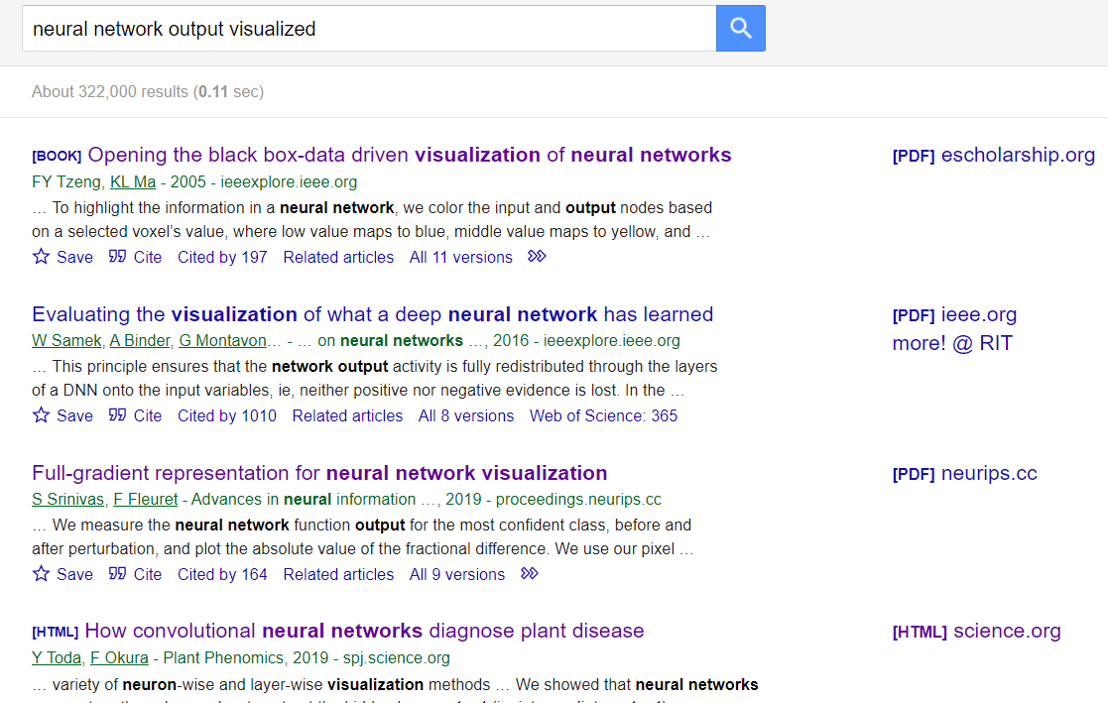
Previous work:
Notes:
We did what everyone else does
Relevant work
Google

Slide 15
Previous work:
Notes:
We did what everyone else does
Relevant work
Google

Slide 16
Previous work:
Notes:
We did what everyone else does
Relevant work
Google

Slide 17
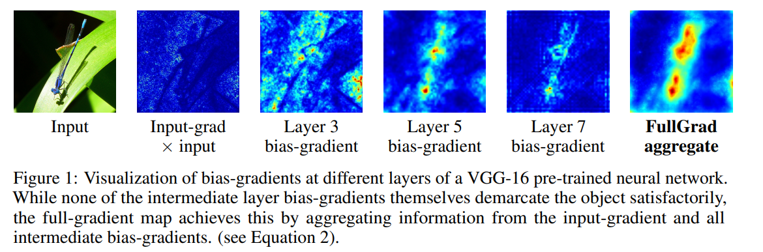
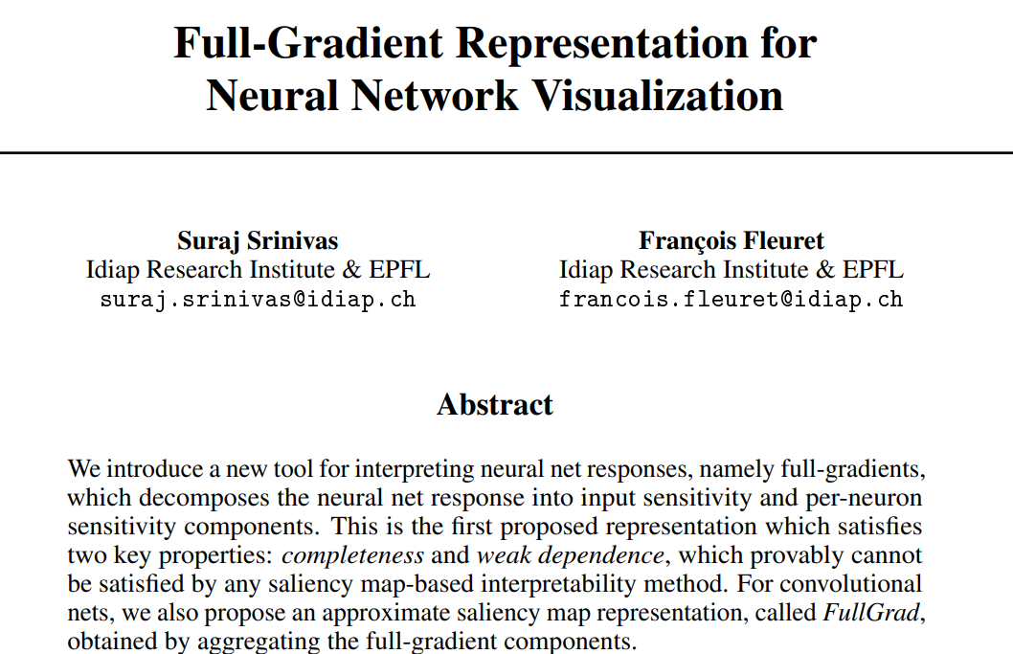
Previous work:
Notes:
Cool but not quite what we are looking for. We want the Terrain of this NN not what is important or key features or pixels.
So yes not useful

Slide 18
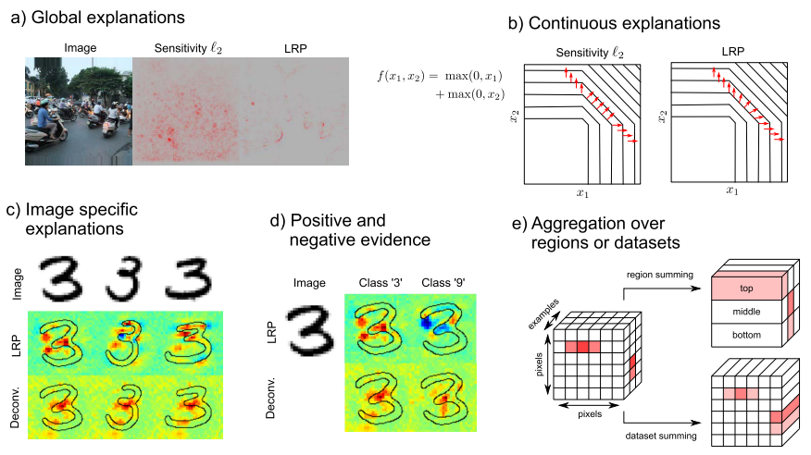
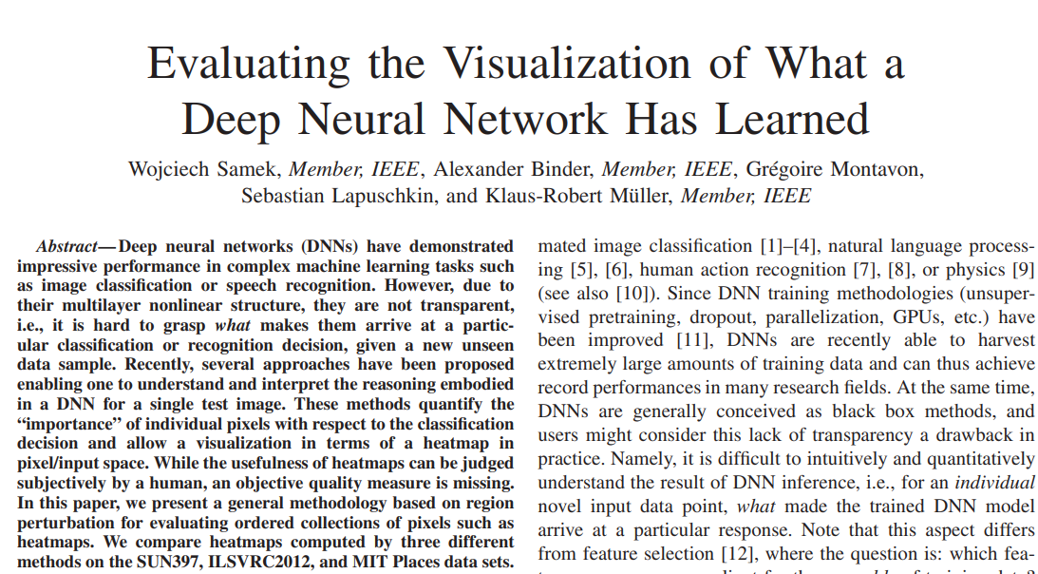
Previous work:
Notes:
This paper is on how to evaluate these heat maps. Again, cool, but not helpful. We want to view the network as a terrain not evaluate individual images.
Heat map evaluation <feed the idea that they seem to be going towards the brute force approach. Exactly .Yes yes nuance. Just make sure u get the nuance>

Slide 19
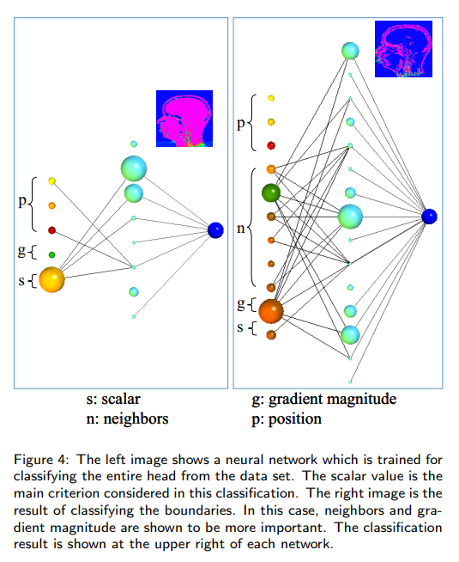
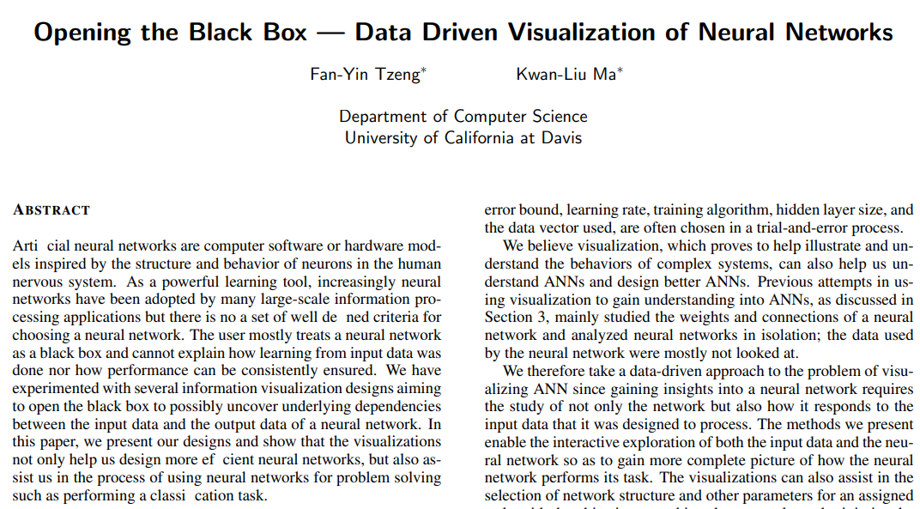
Previous work:
Notes:
Heat maps again. :(
Same stuff again
Brute force all over kinda overfitting ..
They are interesting and they care cool but they are

Slide 20
Previous work: NONE (:
Notes:
No existing literature of this kind of thing. It dances around Explainable AI but again, nothing like what we are doing.
At slide 20
So we have nothing to work with at this point . of the semester .slide 20
20 more to go

Slide 21
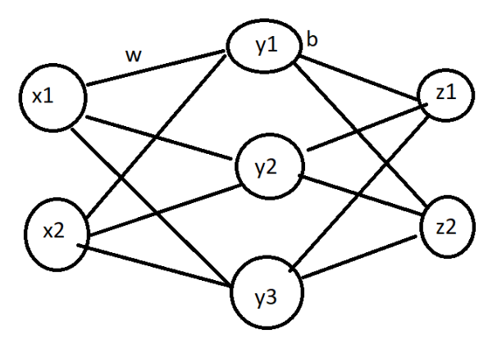
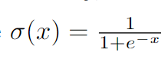
Our First Task:
Visualize what this landscape could look like.
Notes:
Slide 21
Step 1
Visualize what this landscape looks like
I know i know expect questions<its just a bit inaccurate thats all >
So This nn is not actually arbitrary
We took care of all things
“Dan“ - there are 3 total dimensions bc that is what our febal human minds can understand. Thus if we are mapping inputs to outputs we have to have
2 inputs to atleast 1 output. The choice of 1 hidden layer and 3 neurons was arbitrary. The hope was that this will be simple enough to work with but complexe
enough for some mathematical pattern to arise.
Here we have listed our activation function
What each neuron looks like
And the entire ensemble visualized
(Note this is a simple fully connected feed forward network )
So everything goes everywhere
Yes that is written much better

Slide 22
ARITHMOPHOBIA WARNING
The rest of the this presentation may not be appropriate for some audiences.
Viewer discretion is advised.
Notes:
There is more MATHS incoming ..But for real
Lets go

Slide 23
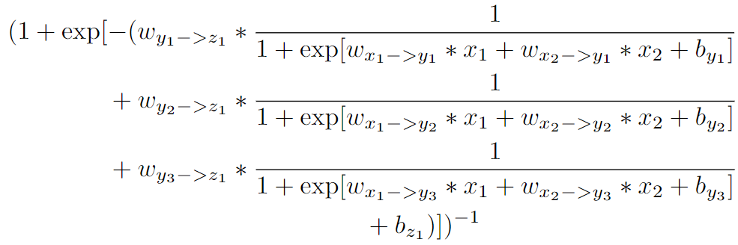
Our First Task:
Visualize what this landscape could look like.
Notes:
This is the equation for Z_1. Remember there will likely be multiple Z
CSCI 635 will help
Note- We are going to keep the activate function and what the neural network will look like just for reference

Slide 24
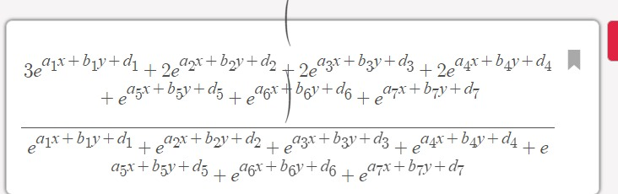
Our First Task:
Visualize what this landscape could look like.
Notes:
We are gonna take the expression
Or if we plugin the right symbols in the right places
Then your “computation graph” in pure maths looks like well
This should look familiar who took neural nets with professor ororbia while also provoking nightmares - “JIV”

Slide 25
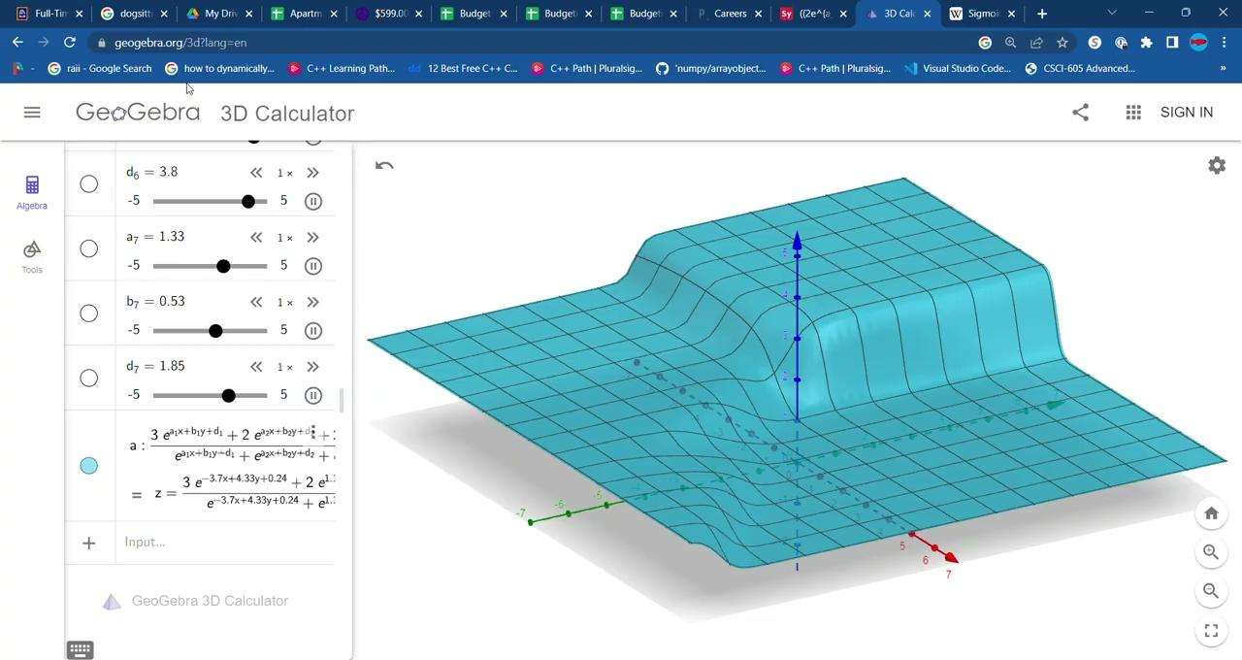
Our First Results:
Visualize what this landscape could look like.
Notes:
FINAL <Q/A> how are we supposed to do this live .. GIVE ME THE EQUATION.
make sure we have
What does that look like on a graphing calculator
<Dan time> Dan rants for 2 -3 minutes .
Does this video actually play?
Okay .so we need to setup a link .<JIV FIX THIS SLIDE IMPORTATN >
So this sorta resembles of what that terrain might look?
What are the reasonable expectations to make of this neural network? Considering thats literally what its taught
How do we know we have sertup the right or wrong thing?
We dont know the full answer to the question but we think this is what “answer might” look like
Next

Slide 26
Project Goal
Visualize what this landscape could look like.
Visualise this landscape in an actual NN
Notes:
Step 1 ?
Step 2

Slide 27
Our Second Task:
Visualise this landscape in an actual NN
Make this network in Tensorflow or Pytorch
Give it a task to optimize
Visualize the output
Notes:
Step 2 Reality
Visualize that same “1” neuron in an actual network
Go ahead now
We have now completed basic visualization of what 1 output neuron could look like
Step 2 Now we need to build an actual neural network to see output of more than 1 neuron and then give it a simple test and visualize the output

Slide 28
Our Second Task:
Visualise this landscape in an actual NN
Make this network in Tensorflow or Pytorch
Give it a task to optimize
Visualize the output
Notes:
So we did that
Simple Tensorflow Network of the drawing the the top right.

Slide 29
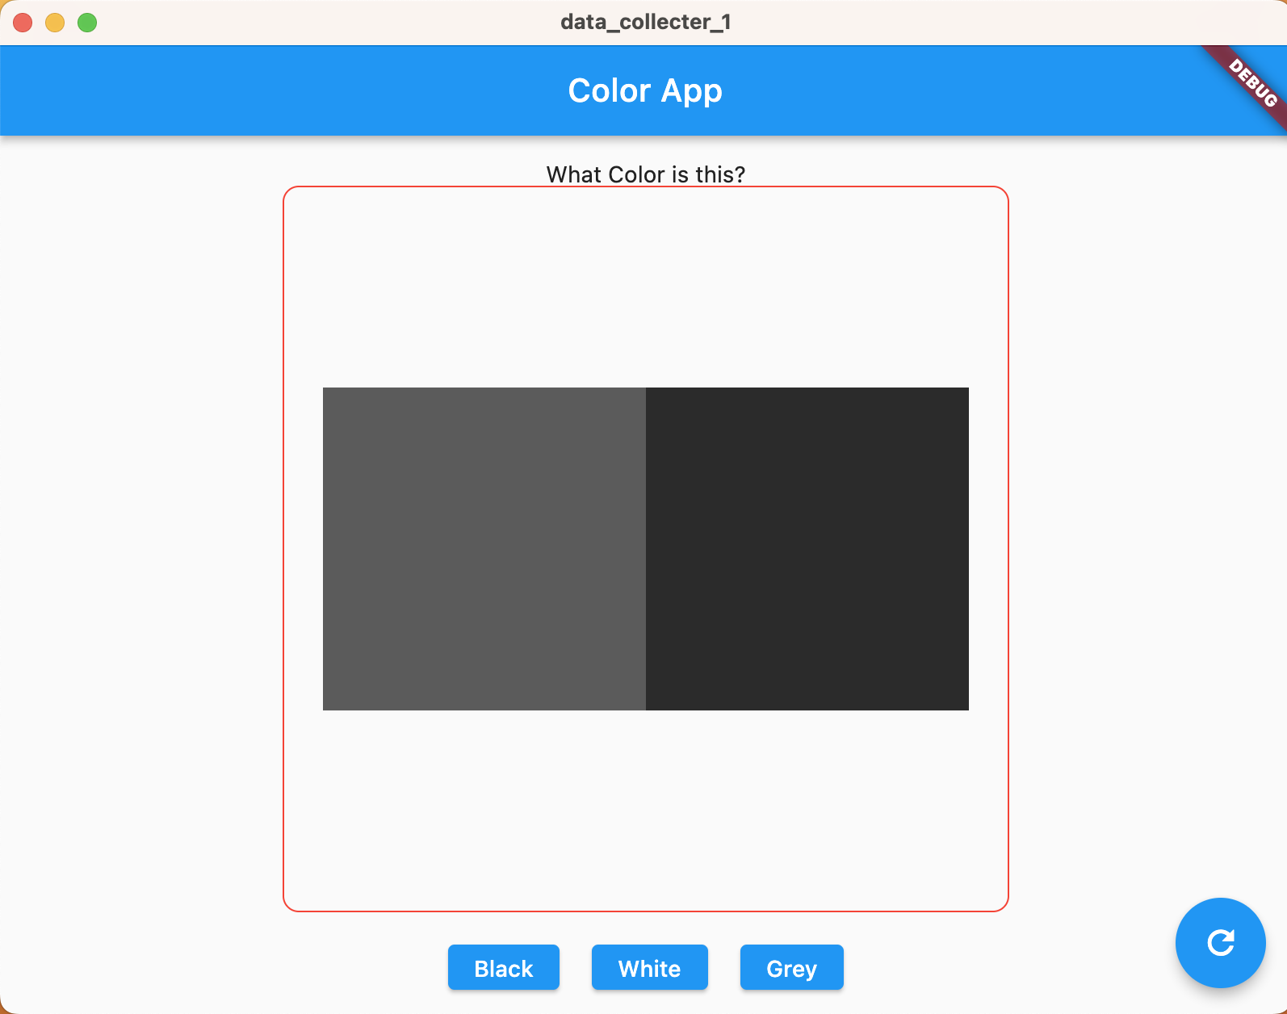
Our Experiment:
Black, White, Grey Experiment
Task: Given 2 pixels, are they Black, White, or Grey?
Mathematically defined dataset
Human labeled dataset
What color is the “image” inside the red box?
Notes:
So experiment. We dubbed this the black white grey experiment
The task setforward is very simple
Given two pixel values is the image black white or grey
Why this experiment? Why specifially this question
We chose this experiment that only needed two inputs and could be also done easily by a human. Its a very simple human annotatable task.
Expect questions
You are asking what is the color of the entire image inside the red box but i see two colors. So feed the idea that that’s exactly what we are asking our NNS to do.
Best of luck with that

Slide 30
Our Experiment:
Black, White, Grey Experiment
Mathematically defined dataset
S1 DEF
P1 >P2 | P1<128
P1 <P2 | P2>128
P1 + P2 =128 | otherwise
S2 DEF :
P1 + P2 < 255 | P1>P2
P1 + P2 <255 | P2<P1
P1 + P2 =128 | otherwise
S3 DEF
P1 + P2 < 128 | P1<128 P2<128
P1 + P2 >128 | P1<128 P2<128
Every 3rd image
Human labeled dataset
A human was given 2 squares and asked if the image is black white or grey.
The dataset is called “human.zip” and is available at: https://drive.google.com/file/d/1E5riOt3Dg_wGxwqwxixbAvKhB1-GSg4o/view?usp=share_link
Black | Grey | White
0 | 128 | 255
Notes:
Now there are three variations of that slider range test
Moving on
Expect questions on third image
This is why time series data doesn’t work
Well it doesn’t know what the third image will be
So we have two more versions and finally our human annotated data
BASIC RL

Slide 31
Our Experiment:
Black, White, Grey Experiment
Mathematically defined dataset
S1 DEF
P1 >P2 | P1<128
P1 <P2 | P2>128
P1 + P2 =128 | otherwise
S2 DEF :
P1 + P2 < 255 | P1>P2
P1 + P2 <255 | P2<P1
P1 + P2 =128 | otherwise
S3 DEF
P1 + P2 < 128 | P1<128 P2<128
P1 + P2 >128 | P1<128 P2<128
Every 3rd image
Human labeled dataset
A human was given 2 squares and asked if the image is black white or grey.
The dataset is called “human.zip” and is available at: https://drive.google.com/file/d/1E5riOt3Dg_wGxwqwxixbAvKhB1-GSg4o/view?usp=share_link
Black | Grey | White
0 | 128 | 255
Notes:
Now there are three variations of that slider range test
Moving on
Expect questions on third image
This is why time series data doesn’t work
Well it doesn’t know what the third image will be
So we have two more versions and finally our human annotated data
BASIC RL

Slide 32
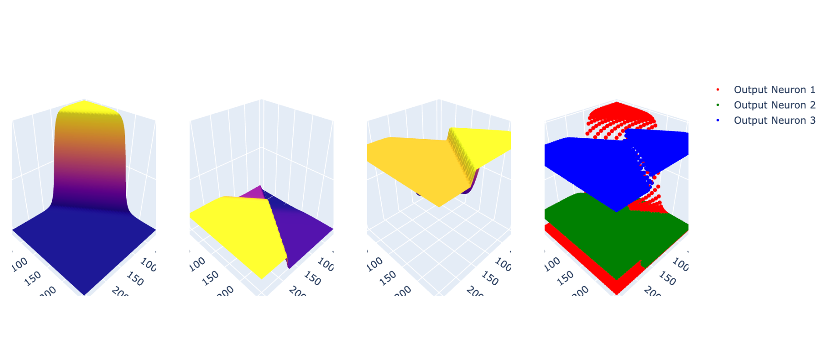
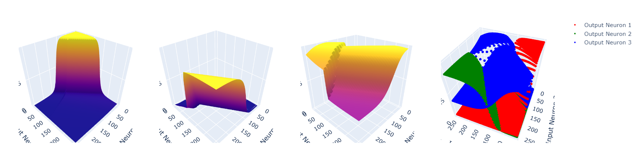
Our results to Black, White, Grey:
Human Data
Math Data
Notes:
Maybe add live demo of probram. It was right about when we made this that we met with Cyril and the idea of finding these boundaries came up.
“This will be S1 ..make it for S1 s2 s3 s4 ..fix previous mistakes- JIVI”
Show s4? Add graph of human annotated data- < draw graph>
Got it
Gets actually 80-% accuracy
Show how it doesnt pick certain options etc etc
Include all weird ones
This is blackhole.t
This is only worked on if we have time
Call out boundaries before leaving this slide. Zoom in on the right side image
Show those boundaries. Those boundaries are what we are looking for right? Thats when we know it switched from one to the other.. Now if we want to know when a neural network will fail all we have to do is find these boundary points and find boundaries that dont make sense

Slide 33
Project Goal
Visualize what this landscape could look like.
Visualise this landscape in an actual NN
Find limits/boundaries between these plains
Highlight their intersections
Notes:
Step 2 has been completed but now we have step 3. Find the boundaries/limits of each plain
Lets go

Slide 34
Our Third Task:
Find limits/boundaries between these plains and highlight their intersections
(Z_1 = Z_2), (Z_1 = Z_3), (Z_2 = Z_3)
Notes:
We set it equal to each other

Slide 35
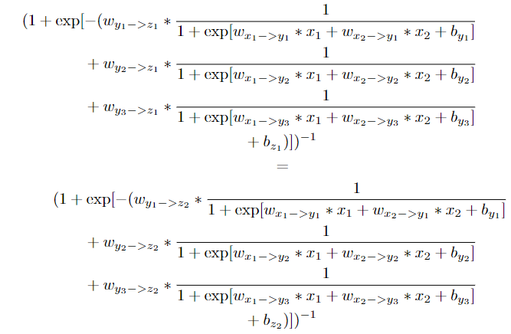
Our Third Task:
Find limits/boundaries between these plains and highlight their intersections
(Z_1 = Z_2), (Z_1 = Z_3), (Z_2 = Z_3)
Notes:
We set it equal to each other

Slide 36
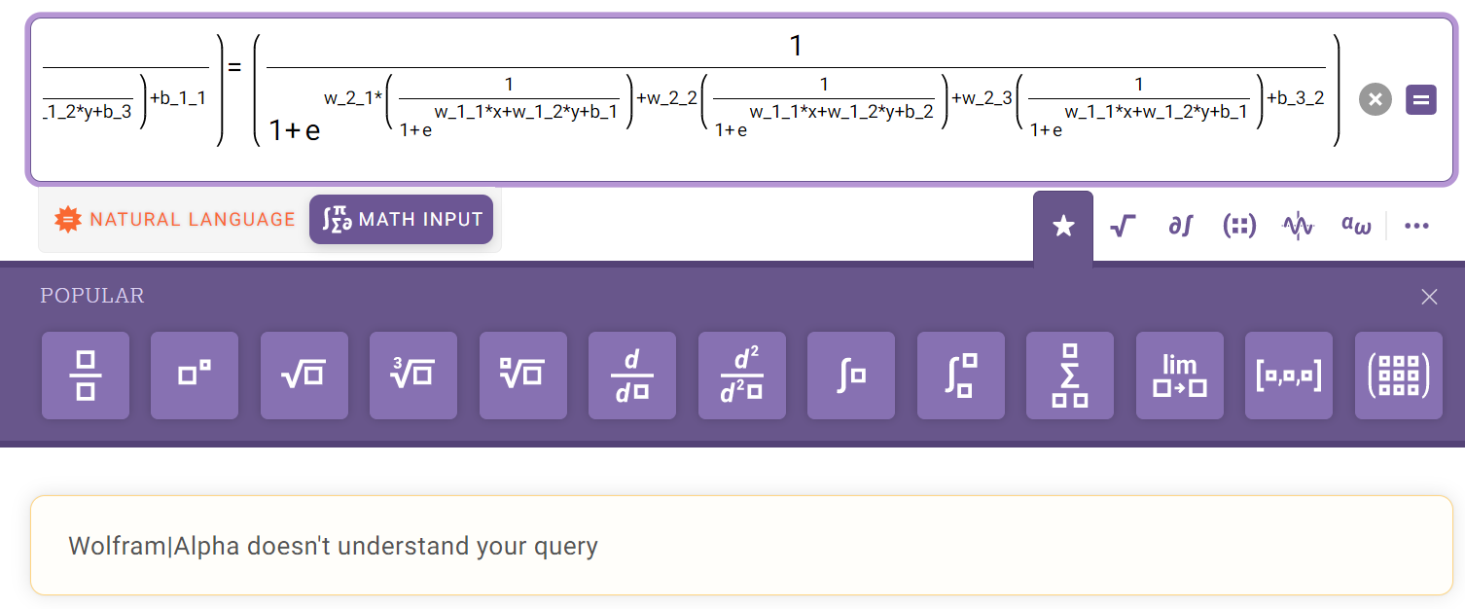
Our Third Task:
Find limits/boundaries between these plains and highlight their intersections
Notes:
We set it equal to each other

Slide 37
Our Third Task:
Find limits/boundaries between these plains and highlight their intersections
Notes:
We set it equal to each other

Slide 38
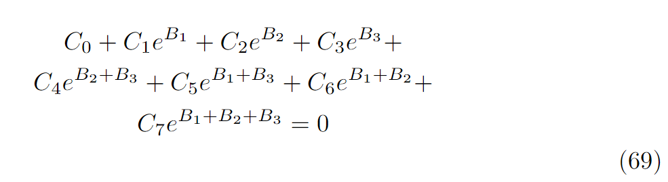
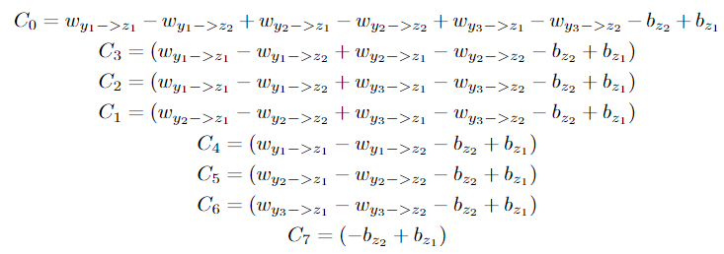
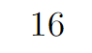
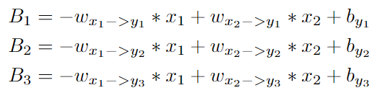
Our Third Task:
Find limits/boundaries between these plains and highlight their intersections
Notes:
After 16 pages of latex you get down to this. Where C_n are all constants and B1,B2,B3 are
So do what a normal person “Wont” do .and then you get typing for 16 pages because math
Then we get
The equation on the left is what we are working with
The constants C0 through C7 and we got our B1 to B3 below it and so we take out simplified equation
Just taking B and C as constants
And we ask wolfram again
Help us
And it giveeesss ussss

Slide 39
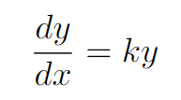
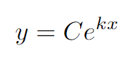
Our Third Task:
Find limits/boundaries between these plains and highlight their intersections
Given:
The General solution is:
Notes:
For those who completed Diff. Eq. Remember the basics
Dan takes over
Given this differential equation
This is the solution

Slide 40
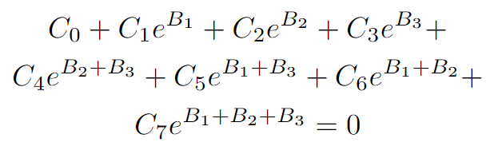
Our Third Task:
Find limits/boundaries between these plains and highlight their intersections
Our equation:
Given:
The General solution is:
Notes:
For those who completed Diff. Eq. Remember the basics
You will know that the following is a “true” statement
Our equation on the other hand
WHAT THE HELL .ITs right there
There is a structure here
There is a pattern here
There is a way to maybe filter out the important parts or represent it in a fashion that is useful
As a an maths student and as an enginnering student
There is too much structure here
Lets go

Slide 41
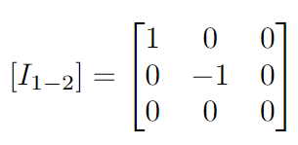
And this is where we are now:
Our equation(s)
Notes:
Thats where we are at right now
You can write this in matrix notation
You get an “i” term
There are problems to that one too
Related math is

Slide 42
And this is where we are now:
Model: GaussianNB
Accuracy: 52%
Modifying pixel:
Row: 0
Column: 15
Pixel_val: +1
prediction from: 9 to: [2]
Original image:
Modified image:
Pixel that changed( by value : 1 )
Notes:
Notes
Second experiment time talking about means?
Traversing an mnist image
Changing a pixel by plus or minus 1 and see if that changed the output of the neural net
This is important because it demonstrates that there are boundary conditions even in used neural nets on real problems like Gaussian NB and and MNIST
Well we had a toy neural net .and we had a toy image
But that same idea .could be applied to just an off the shelf net on any dataset it has learnt
Sooo. To conclude —---
Its important it demonstrated there are boundary conditions that you can use to apply on any learned net
<TODO JIV> if time permits
Moving on i guess? Yeah yeah but just like some pointer for us to look and talk about. Any tiny pointer

Slide 43
Future work:
Work back into Diff. Eq. and use numerical methods to approximate x1 and x2… Xn
This will be like nested integral that we do not want to actually solve but rather approximate
This work moves into the Boundary Value problem which has extensive research but needs more time to understand.
Understand Variational Spline theory
Make an algorithm that given a feedforward NN architecture can output the points that are boundaries for the NN classifications.
Notes:
Explicitly, the idea going foward is to convert this into a system of
differential equasions. Then use numerical meathods to get a ”close
enough” solution that can be computed in ”reasonable” time. Equ.
69 is directly related to the variable B. Whatever method used to
aproxomate B can be used again for the components of B. Since B is
not the variables we care about, this proccess will be generalizable,
and SHOULD scale to ”deaper” equasions (This translates to allowing
one to solve arbitrarily deap NN). It is also interesting to note that
x1 and x2 are not dependent variables. They are independent since
the value of input neuron 1 is not related to the input neuron 2
value. This impleis that for tasks such as image detection and image
processing where 1 pixel is not related to the value of another pixel
will be inherintly different than other tasks such as forcast predictions
(where sunlight, windspeed, terrane, etc. are all dependent on each
other). For our purposes, having x1 and x2 be indepenent means that
16
hey can be decoupled allsowing for simpler ODE meathods. Being
able to use simplar ODE methods means this will be be scaleable to
xn.
text
TLDR: By solving for B instead of directly for x1, x2 than there is a
method for solving Deep NN’s. Having x1, x2 be independent vari-
ables than we can solve for an arbitrary number of inputs.
I have seen this file before . This notes i understand .sorta except some words .

Slide 44
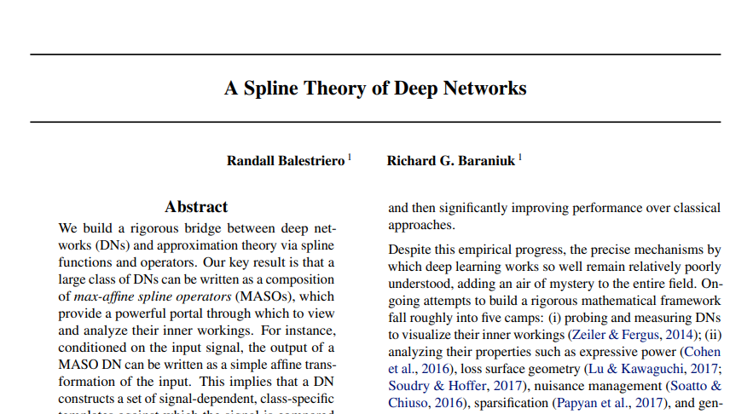
Current Related Work:
Notes:
This was in a talk .This was published in 2018
This paper talks about taking a neural net and its complicated output function and representing it as a spline of many tinier functions specifically for the ReLu function and directives of it
This work started to bridge the gap between the mathematics of machine learning and the rest of mathematics .

Slide 45
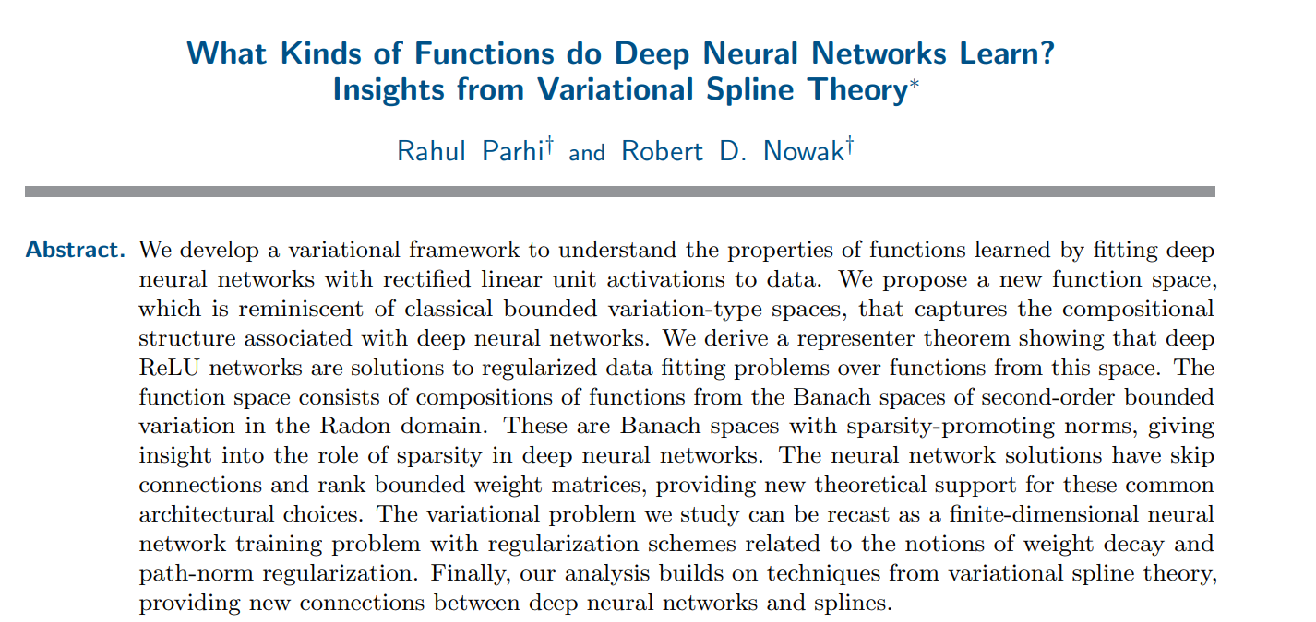
Current Related Work:
Notes:
What if showed all the papers side by side .?
Okay Never mind let me see if time permits
Notes
Dan- Paper is literally obscure maths black magic
It claims
It has bridged the gap between neural nets that use relu activation functions and the rest of mathematics and that it is a valid solution for Data fitting problems over function over a new function space. They define this function space as finite definite optimization space or variation-type spaces.
This paper shows that Relue NN are valid solutions of the variational optimization problem in Banach Space -> “optimization hell”

Slide 46
What we learned through this process:
Sometimes even obvious seaming questions have not yet been asked.
It can be very hard to explain a new idea to someone without visual props.
Sometimes it is easy to get bogged down in the work and loose light of the goal.
Different people will have different strengths and weaknesses and those differences should be leveraged rather than dismissed.

Slide 47
Sources
https://ai.plainenglish.io/neural-networks-for-beginners-b54e8e118c7
https://www.ibm.com/watson/explainable-ai
https://ieeexplore.ieee.org/abstract/document/1532820
https://ieeexplore.ieee.org/abstract/document/7552539
https://proceedings.neurips.cc/paper/2019/hash/80537a945c7aaa788ccfcdf1b99b5d8f-Abstract.html
https://en.wikipedia.org/wiki/Explainable_artificial_intelligence
https://www.wolframalpha.com/
https://drive.google.com/file/d/1E5riOt3Dg_wGxwqwxixbAvKhB1-GSg4o/view?usp=share_link

Slide 48
Q&A
Original image:
Modified image:
Model: GaussianNB
Accuracy: 0.52
Modifying pixel:
Row: 0
Column: 15
Pixel_val: +1
prediction from: 9 to: [2]
Notes:
Dimensionality questions

Slide 49
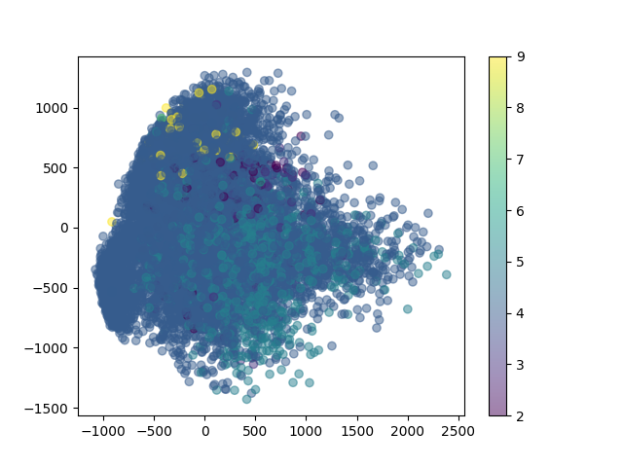
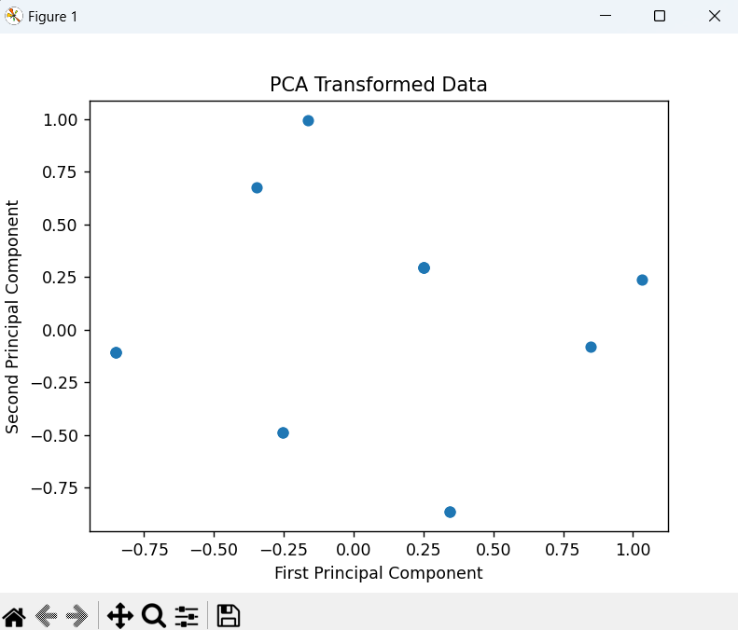
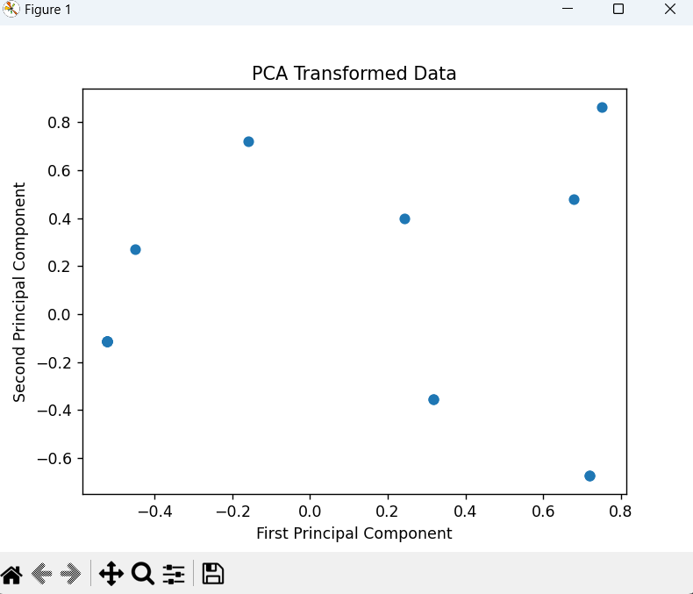
In case of dimensionality reduction question:
The neural network visualized (as feasibly as possible using dimensionality reduction)
After x.shuffle() for a 4D cube vertices

